Slide 1

Project Title - Seasonal Agriculture Performance Analysis
[Student Name : Atthota Jyothika
College Name- Hyderabad Institute of Technology and Management]
AICTE STU ID : (STU6867f55fd8f021751643487)

Slide 2

PROBLEM STATEMENT
Agricultural activities are influenced by seasonal variations in environmental conditions, farming practices, resource availability and market conditions. As a result, agricultural performance may differ from one season to another. However, raw agricultural data does not clearly explain how agricultural performance changes across seasons or what patterns can be observed in different seasonal conditions. The problem is to analyze the given agricultural dataset and investigate seasonal differences in agricultural performance by identifying meaningful patterns, trends, relationships and variations within the available data.

Slide 3
Project Description Seasonal Agriculture Performance Analysis — Analyzed agricultural data across different seasons to identify variations in crop yield, production, environmental conditions, resource usage, and economic performance using Python, Pandas, NumPy, Matplotlib, Seaborn, and statistical analysis. Performed data cleaning, exploratory data analysis, seasonal comparisons, correlation analysis, visualization, and evidence-based interpretation to support better agricultural planning.

Slide 4

WHO ARE THE END USERS?
Farmers – Can use seasonal insights to plan crops, water usage, fertilizer usage, and farming activities.
Agricultural Officers – Can analyze seasonal performance and identify areas that may need support or intervention.
Agricultural Planners & Researchers – Can study seasonal trends, environmental conditions, crop performance, and resource utilization.
Agribusinesses – Can use production and economic insights for planning procurement, resources, and market activities.
Government / Agricultural Departments – Can use aggregated findings to support evidence-based agricultural planning and resource allocation.

Slide 5

Technology Used
Python – used for performing the analysis.
Pandas – used for loading, cleaning, and analyzing the dataset.
NumPy – used for numerical calculations.
Matplotlib – used to create graphs and charts.
Seaborn – used for better data visualizations.
SciPy – used for statistical analysis such as ANOVA.
Google Colab – used to write and run the Python code.
CSV – used as the dataset format.

Slide 6
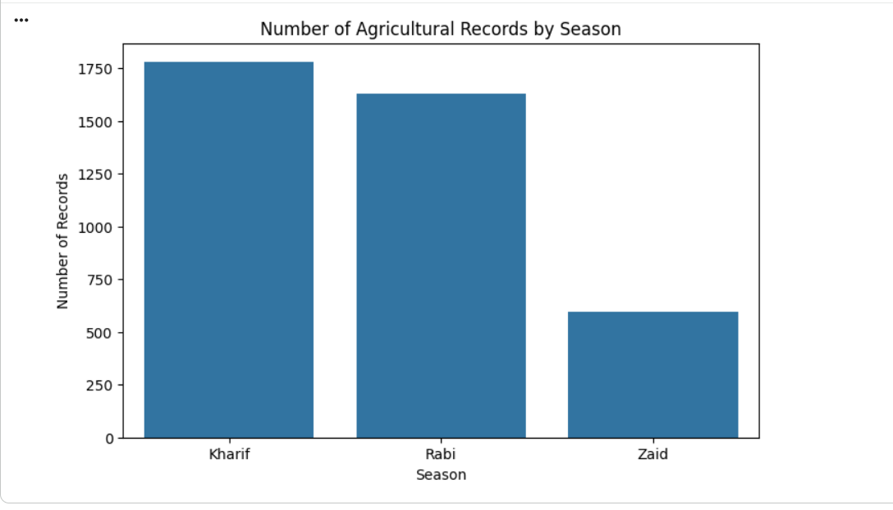
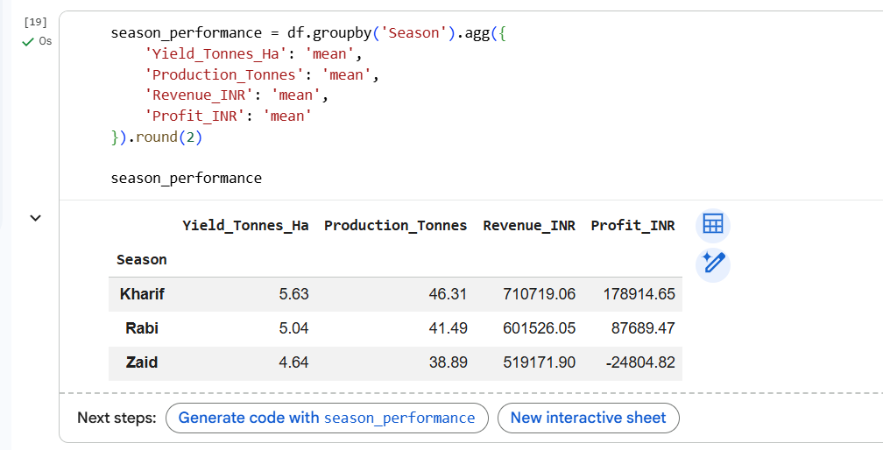
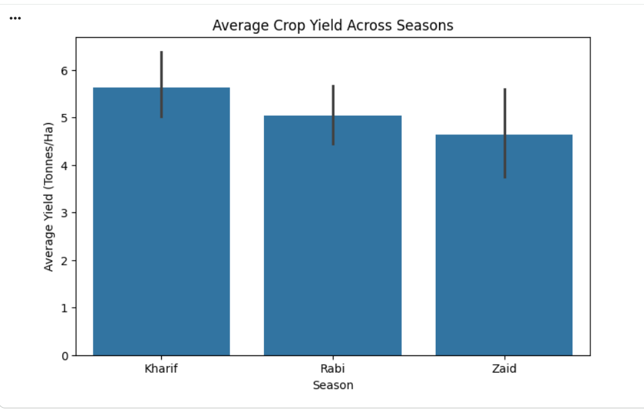
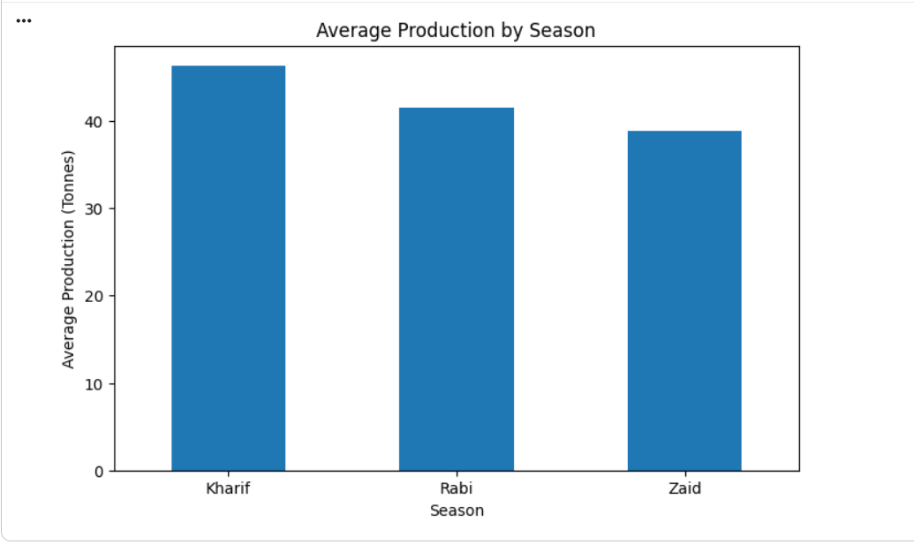
RESULTS

Slide 7
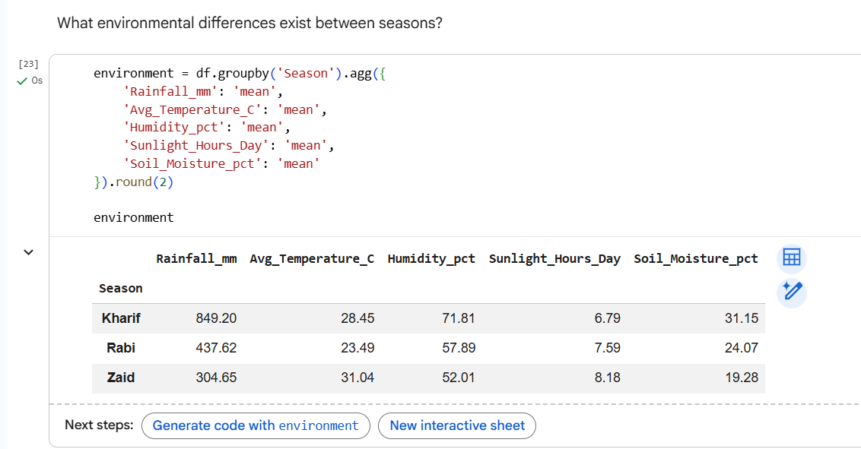
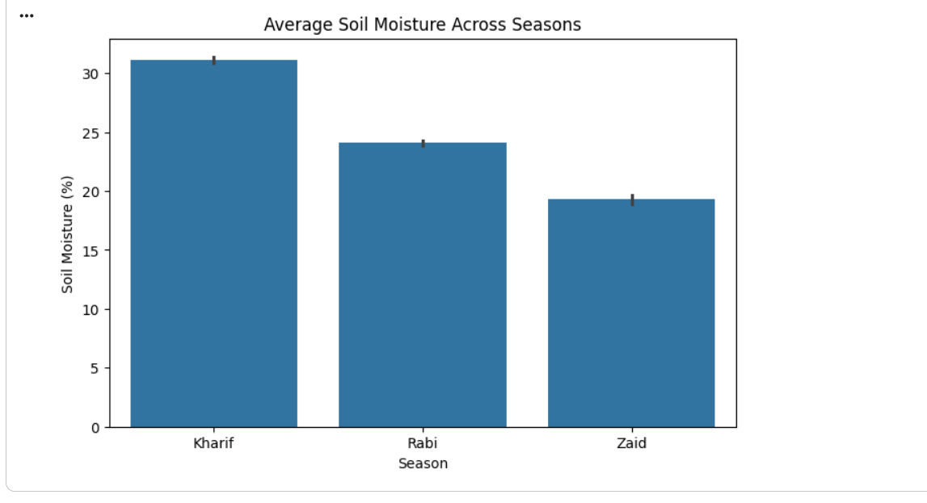
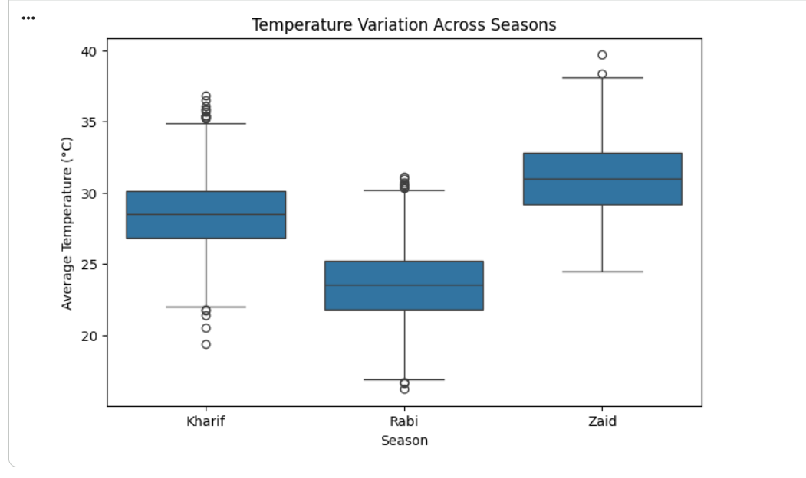
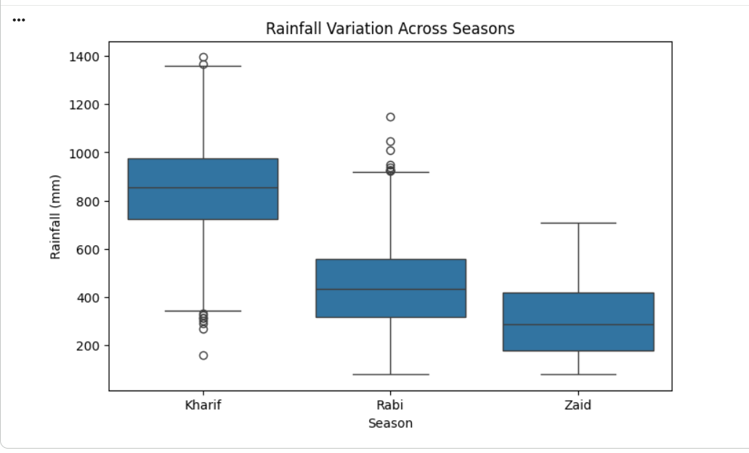
RESULTS

Slide 8
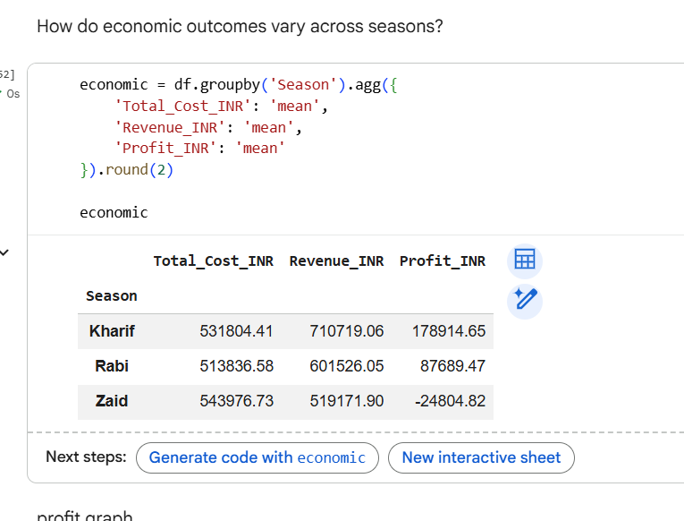
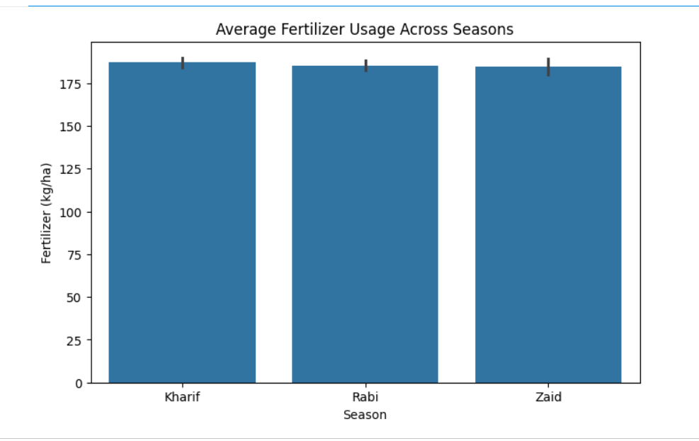
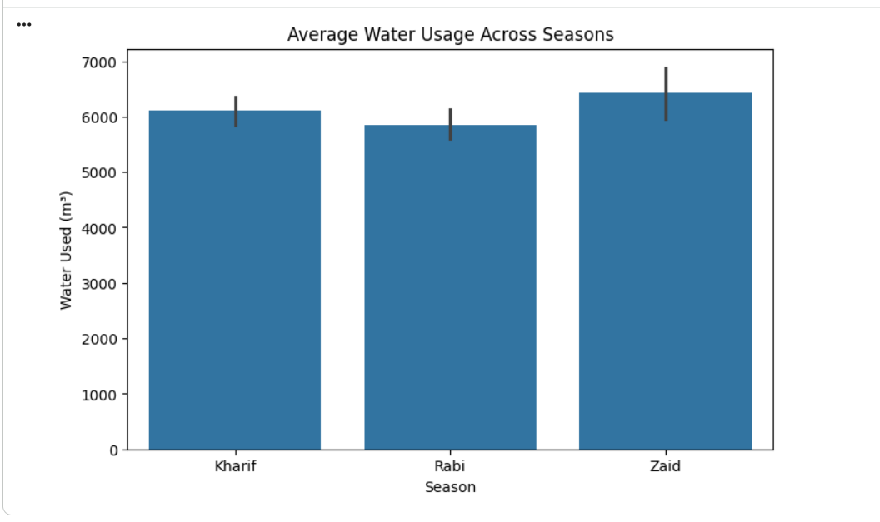
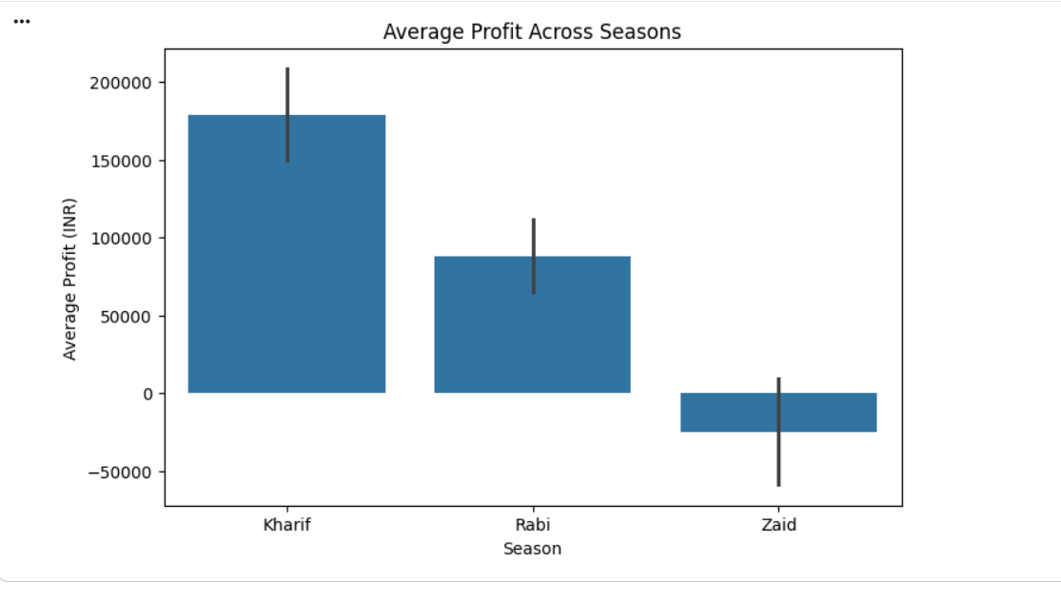
RESULTS
[Add screen shots of your code ]

Slide 9
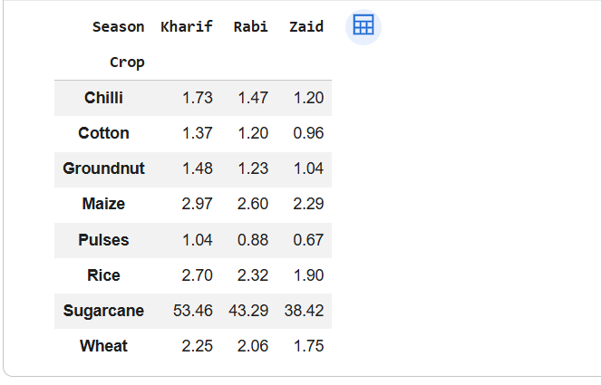
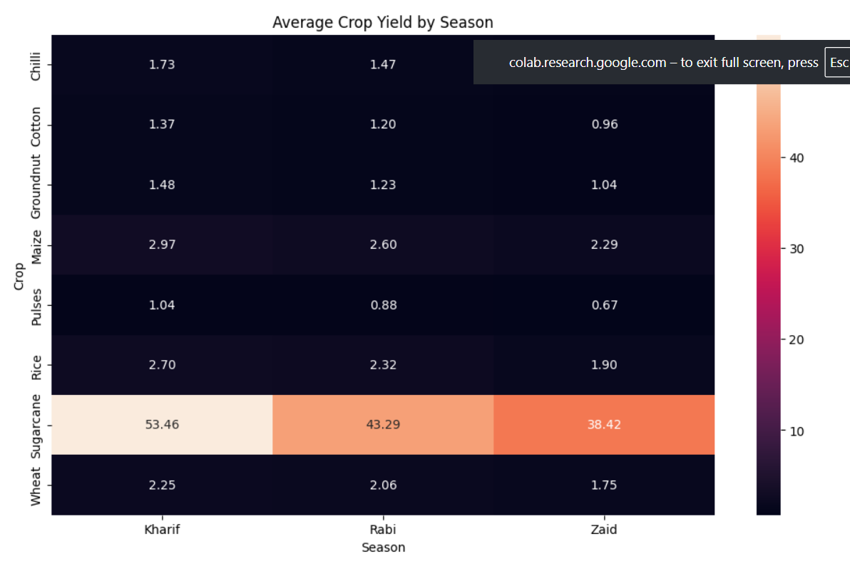
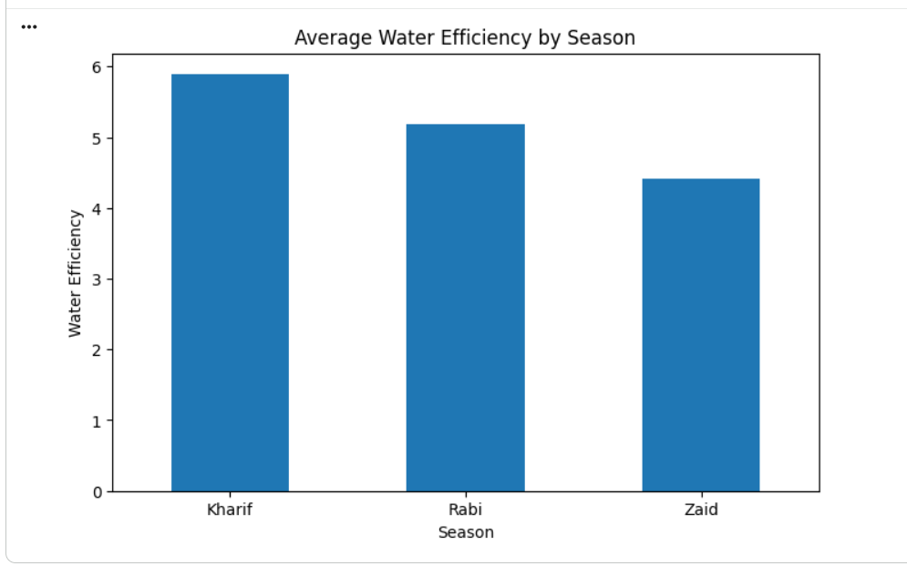
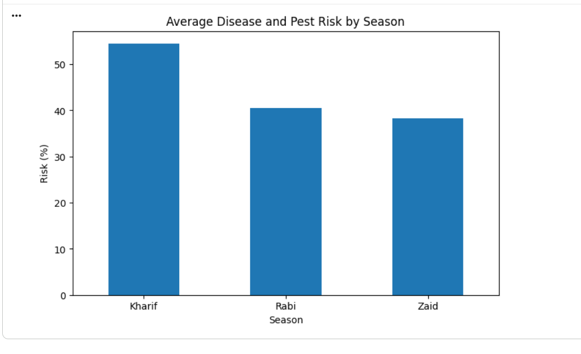
RESULTS
[Add screen shots of your code ]

Slide 10
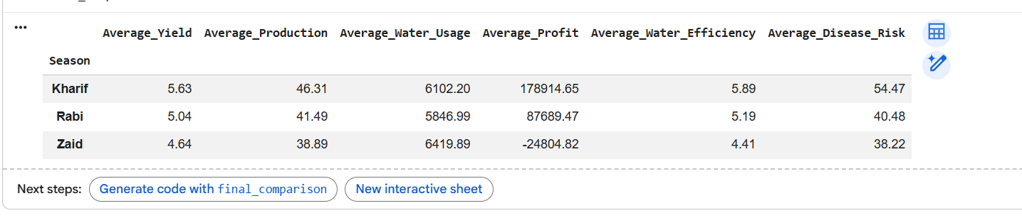
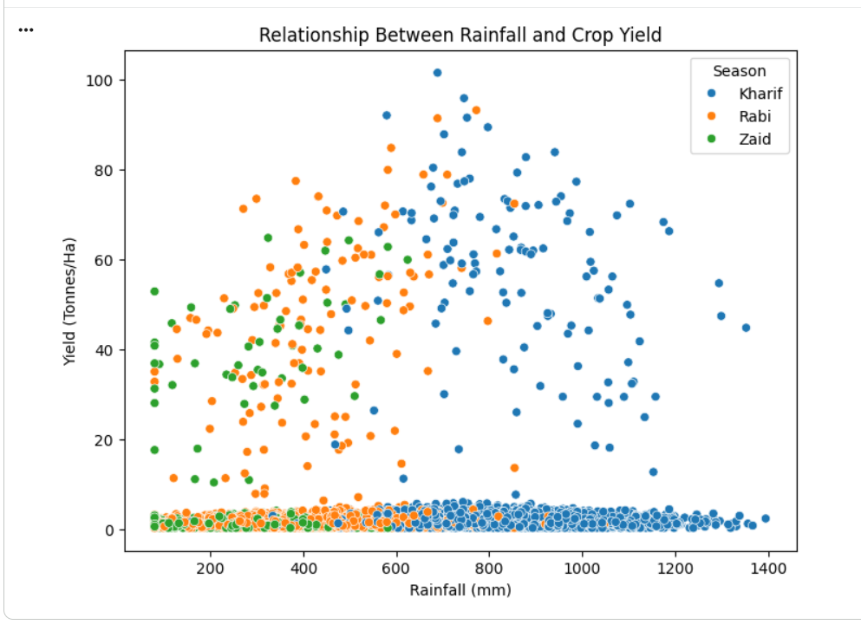
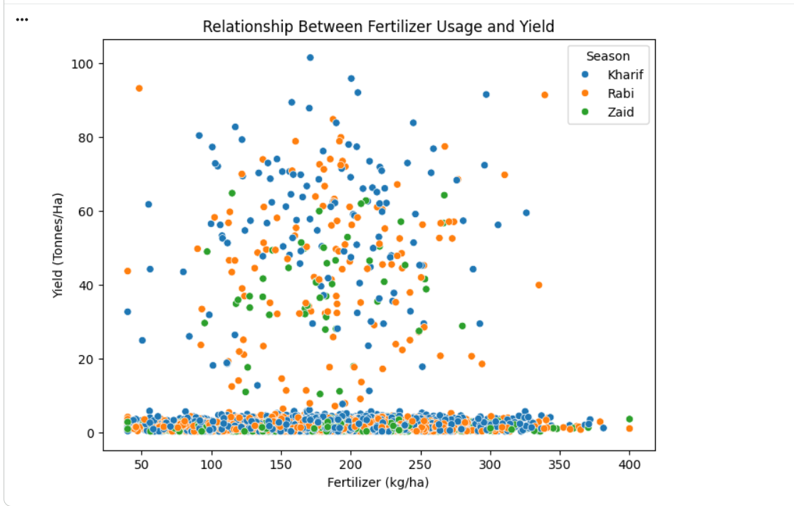
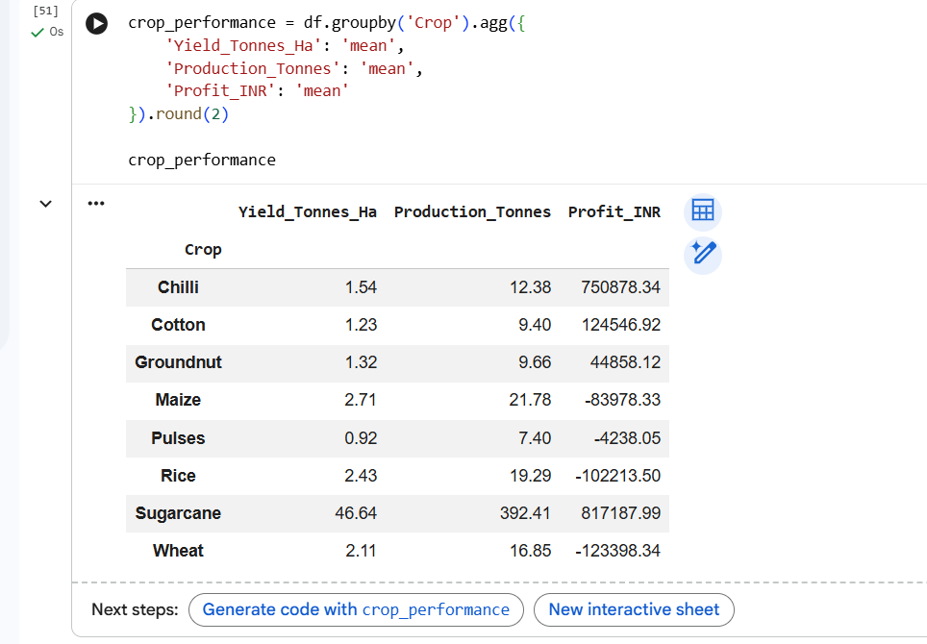
RESULTS
[Add screen shots of your code ]

Slide 11
Future scope
Extend the study with multi-year agricultural data.
Include weather and market-price factors.
Build a dashboard for easy seasonal comparison.
Develop crop and yield prediction models.
Identify early seasonal risks.
Support smarter crop and resource planning.

Slide 12
GitHub Link
https://github.com/JyothikaAtthota/data_analysis---Seasonal-Agriculture-Performance-Analysis.git

Slide 13
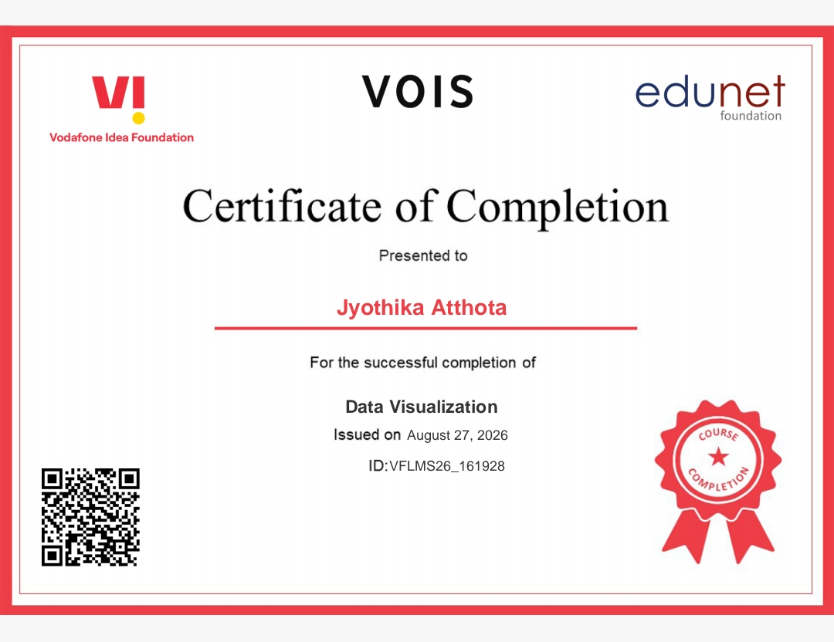
VOIS Course completion certificate - Course name- Data Visualization

Slide 14

Thank you
.
.

